Slide 1

SIMPLE TEXT EDITOR
Team Members:
Rashmi K R PES2UG20CS266
Reshmi Pradeep PES2UG20CS270
Rimzim Sanghvi PES2UG20CS273

Slide 2
ABSTRACT
Text-Editor is an software application which helps user write, edit and format text and save it in a file .
It makes it easier to type texts in different programming languages with special features like auto completion and indentation and run your code from editor.
This text editor was built using python and Tkinter. It also has different themes and formatting options that make it attractive and easy to use.

Slide 3
DELIVERABLES
New File can be created and edited with functions including opening, closing and saving the file.
Editing of content can be done with features such as Cut, Copy, Paste and ‘Find and Replace’ in the file
FILE HANDLING
EDITING
With a range of customizable themes and auto-completion tool, it’s easier to write and format your text or code.
Compilation of the programming language in quite a few languages can be done and code can run directly from text editor.
FORMATTING
PROGRAMMING
Simple Text Editor is presented with purpose to provide users an application to open any text file, write, edit and format text which summarizes all deliverables such as Editing, Formatting , Programming and File Handling.

Slide 4
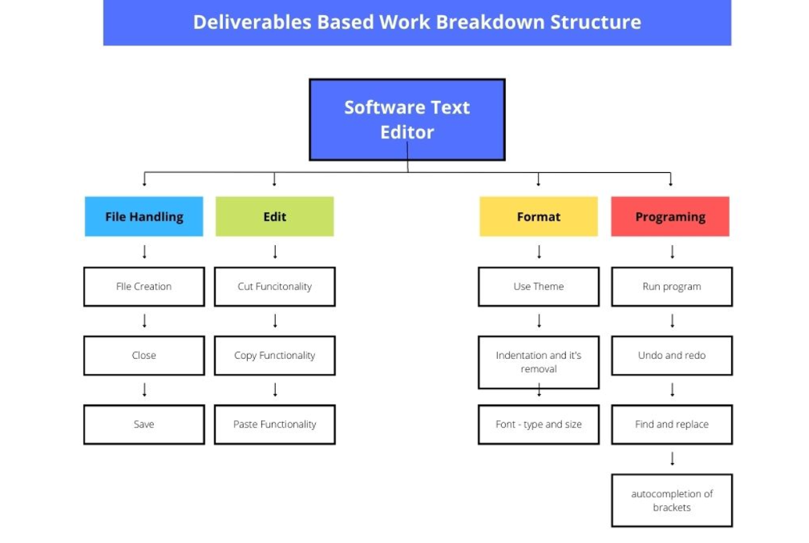
WORK BREAKDOWN STRUCTURE

Slide 5
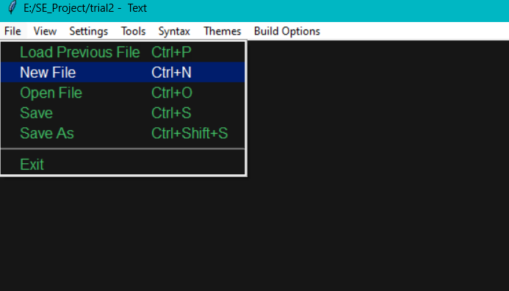
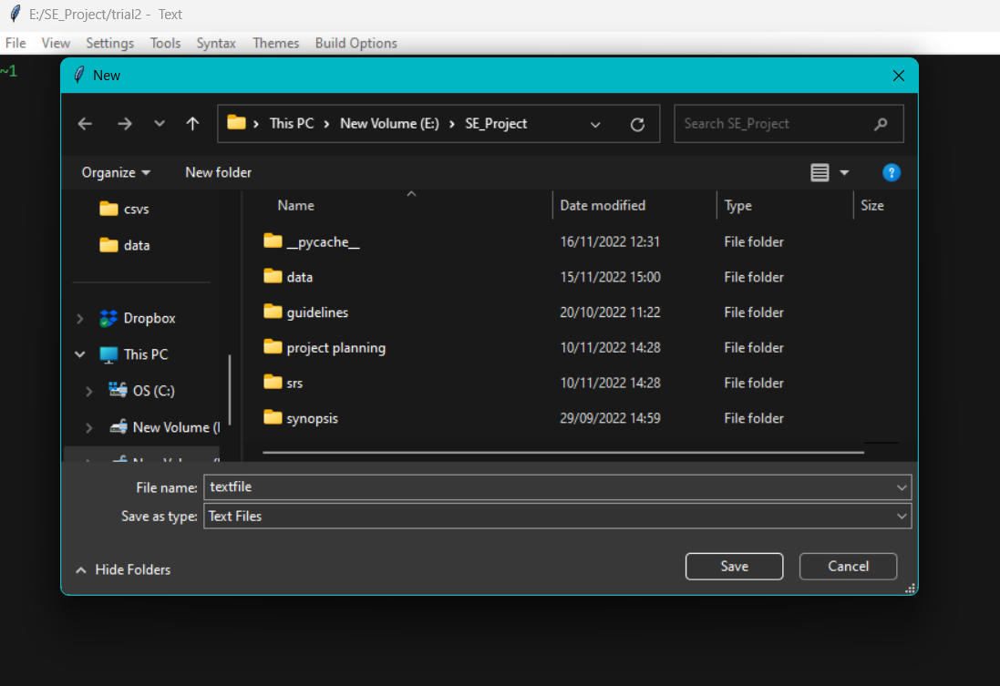
SNAPSHOTS
Creating a new file

Slide 6
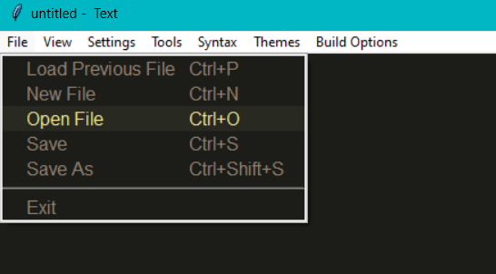
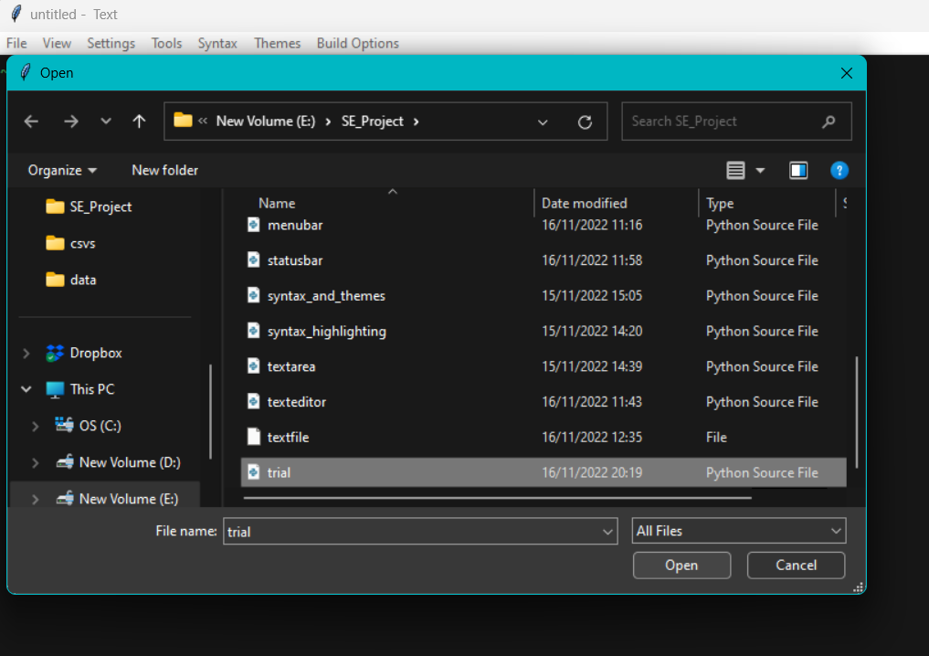
Opening a file

Slide 7
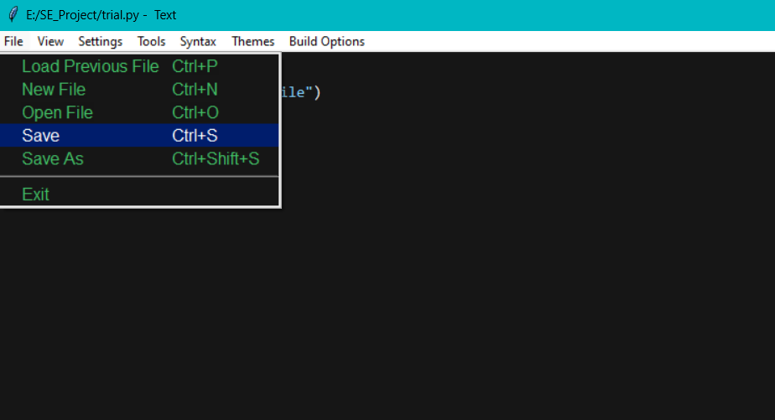
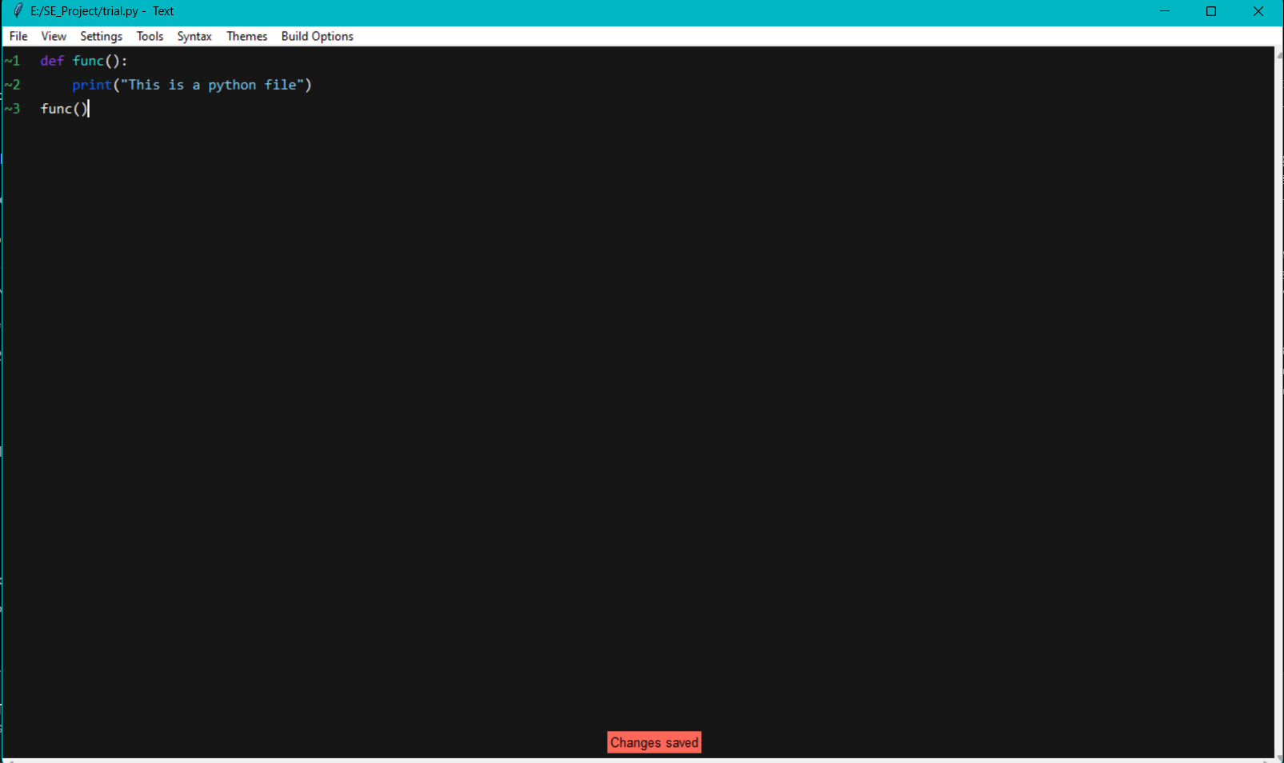
Saving a file

Slide 8
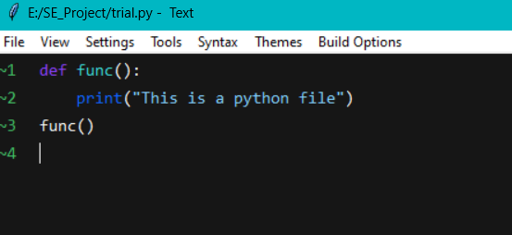
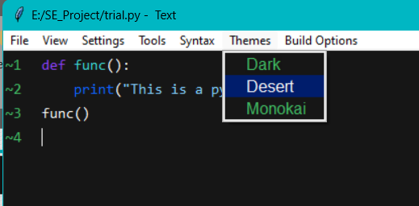
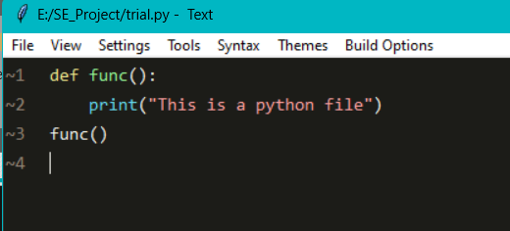
Changing the theme of the editor

Slide 9
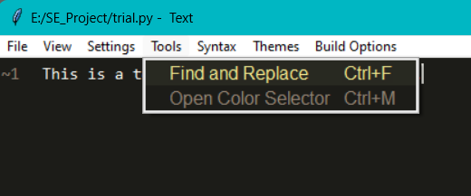
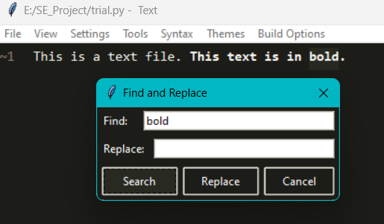
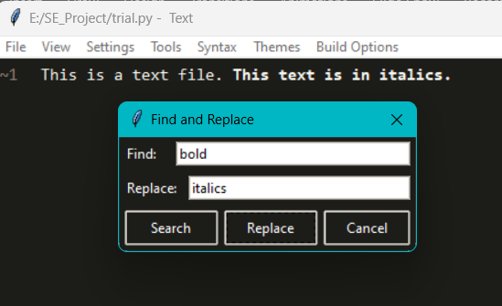
Editing a file
Using find and replace: a file

Slide 10
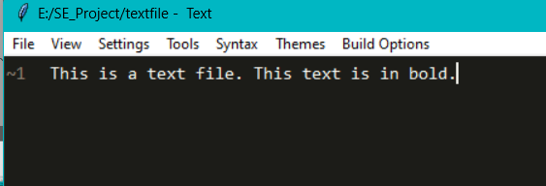
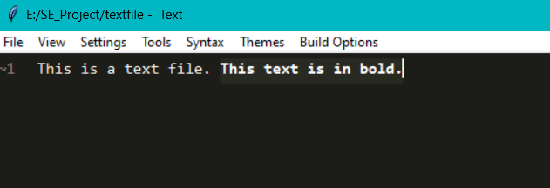
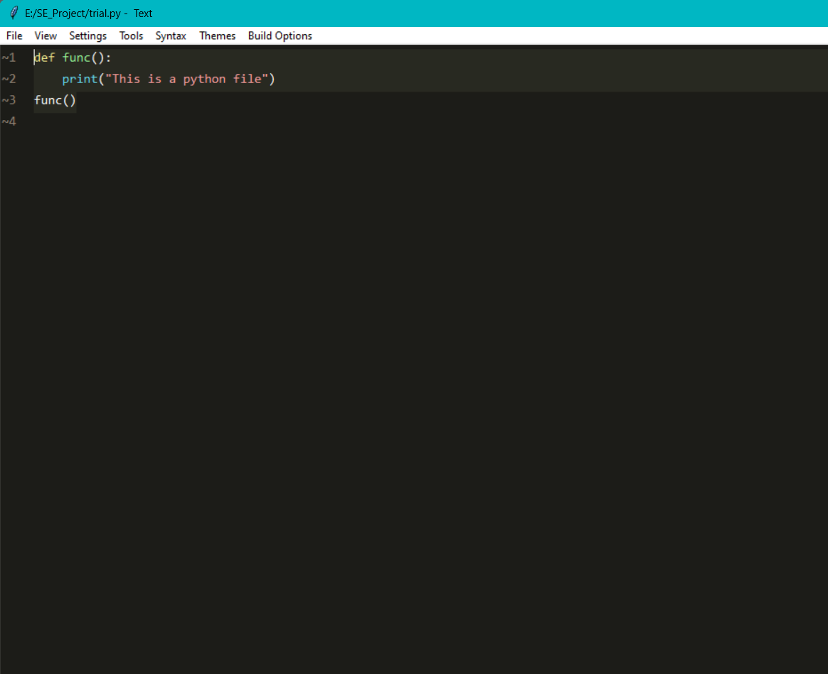
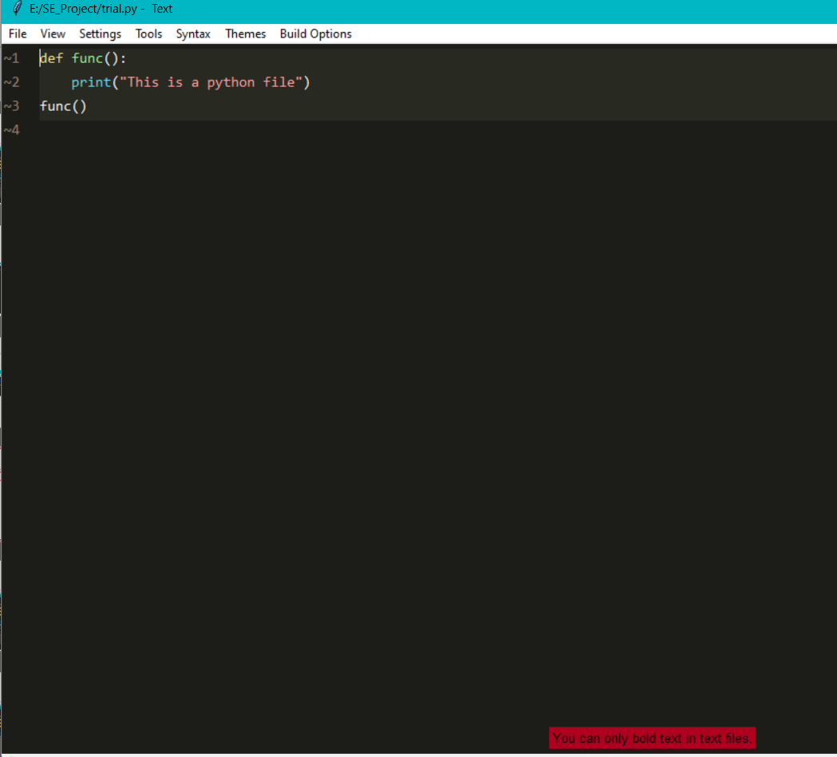
Formatting a file
Ctrl + B

Slide 11
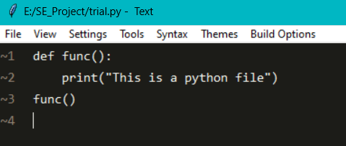
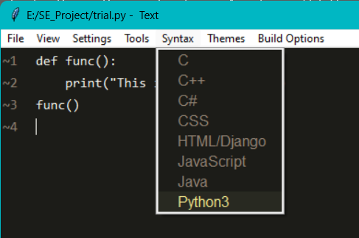
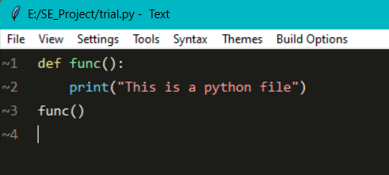
Syntax Highlighting

Slide 12
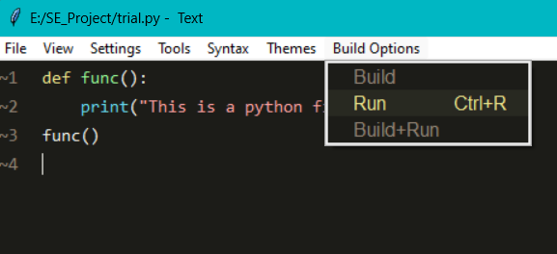
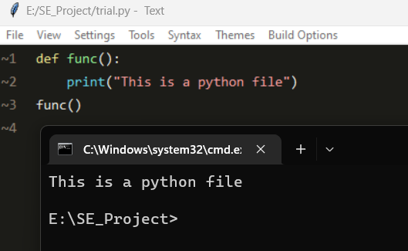
Executing a program file

Slide 13
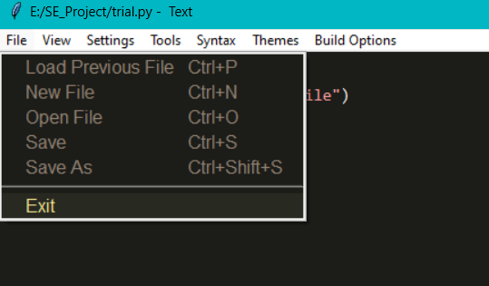
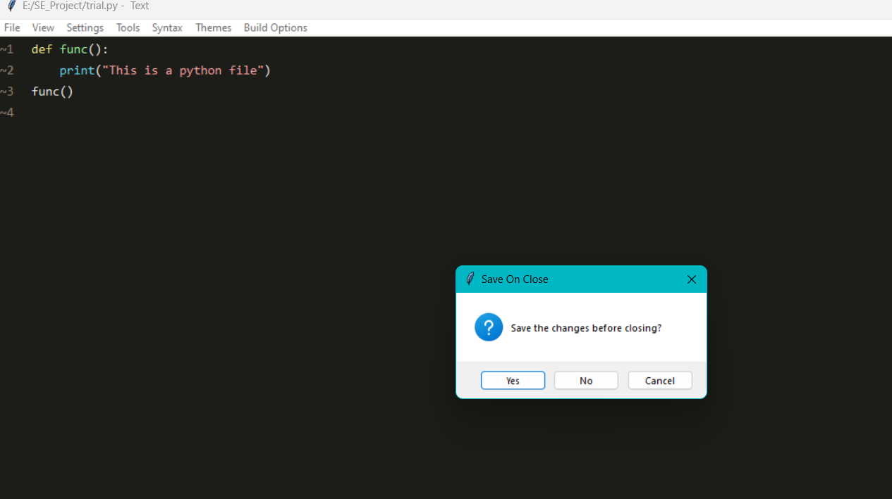
Exiting Text Editor/ Closing file

Slide 14

CONCLUSION
The software application is created with a pleasing layout which includes all the basic functionalities such as editing, formatting and handling data in files. It is useful for anyone who wishes to take notes or code with ease with an interactive user interface and customizable themes.

Slide 15
THANK YOU

